Slide 1
HTML Training

Slide 2
- HTML stands for HyperText Markup Language.
- It is most widely used language to write Web Pages.
HTML is a MarkUp language
Html is browser understandable language.
- Markup Language describes how the HTML works. With in markup language, you simply markup a text document with tags and that tells the web browser how to structure it to display.
-HyperText Refers to the way in which webpages(Html Documents ) are linked together. When you click a link in a webpage, you are using the hypertext.
All we need to do to use html is to learn what type of markup to use to get the results you want
Why to learn html
It is possible to create the web pages without knowing anything about the html source behind the page
There are excellent editors on the market that will take care of html parts
All you need to do is layout the page

Slide 3
However, if you want make it above average in web design, it is strongly recommend that you understand the tags
We are having a lot of html web builder in the market
Ex Web press,Grapesjs,silex,mobirise,Bubble
The most important benefits are you can use the tags the editor doesnot support
You can read the code of other people’s pages and “borrow” the cool effects
You can do the work yourself when the editor simply refuses to create the effects you want
Word to know :
Tag : tag is a command the web browser interprets.Tag looks like < tag > tag
<h1> <p> <img>
Element : A complete tag, having an opening tag and a closing tag
<tag> --- opening tag
</tag> ---closing tag
Attribute- used to modify the value of the html elements. Elements will often have multiple attributes.

Slide 4
Html Elements :
An Html element is everything from the start tag to end tag
Start tag* Element content end tag*
<p> This is the paragragh </p>
<a href = “default.htm”> This is the link <a>
<br/>
The start tag is often called the opening tag
The end tag is often called closing tag
Html Element syntax:
An html element starts with a start tag /opening tag
An html element ends with an end tag/closing tag
The element content is everything between the start tag and End Tag
Some HTML elements have the empty content.
Empty elements are closed in the start tag
Most of the html elements can have the attributes

Slide 5
Nested Html Elements
Most html elements can be nested (can contain other Html elements)
Most of the html elements can be nested(can contain other HTML elements
Html documents contains of nested html elements.
Don’t forget the end tag
Some html might display correcly even if you forget the end tag
<p> This is the paragragh
The example above works in most browsers,because the consider as optional
Never rely on this. Many Html elements will produce the unexpected results and /or errors if you forget the end tag
Empty Html Elements
Html elements with no content are called the empty elements
<br> is an empty element with out a closing tag(the <br> tag defines the line break.

Slide 6
Use Lowercase tags
HTML tags are not case sensitive <P> means the same as <p>.Many websites uses the upper html tags
Attributes
The attribute is used to define the characteristics of an elements and is placed inside the element’s opening tag. All the attributes are made of two parts : a name and the value
The value of the attributes are should be put in the double quotation, and is separated from the name by the equals sign
Any html tags have a unique set of their own attributes .
Core Attributes:
The four core attributes that can used on the majority of html elements are
Id
Class
Title
Style

Slide 7
The Id Attribute:
The id Attribute can be used to uniquely identify any element within a page( or style sheet).
There are 2 primary reasons that you might want to use an id attribute on an element:
if an element carriers an id attribute as a unique identifier it is possible to identify that element and its content
If you have two elements of the same name within the webpage(or style sheet)
you can use id to distinguish between elements that have the same name
For now id attribute could be used to distinguish between two paragraphs elements,like below
<p id = “sandeep”>This is the Sandeep</p>
<p id = “sanvik” > This is sanvik</p>
Note : They are some special rules for the value of the id attribute, it must :
begin with a letter (A-Z) or (a-z) and can be followed by the any number of the letters ,digits(0 to 9),hyphens,und erscores,colons, and periods.
Remains unique within that Document, No two attributes may have the same value within the HTML Document

Slide 8
Title Attribute:
The title attribute gives the a suggested title for the element.
The behavior of this attribute will depend upon the element that carries it, although it is often displayed as tooltip or while element is loading
Class Attribute :
The class attribute is used to associate an element with the style sheet, once specifies the class of the element.
We learn more about the use of class attribute when you will learn cascading style sheets.
The value of attribute may also be a space separated list of classNames
For Eg :
class = “className1” “ClassName2” “className3”
Style attribute :
The style attribute allows you to specify the css rules with in the element for eg
<p style = “font-family:arial;color:#FF000”;>some text <p>

Slide 9
Generic Attribute
Here’s table of the some other attributes that are readily usable with many of HTML’s tag
Attribute | options | Functions
align | Right,left,center | Horizontally aligns tags
Valign | Top,middle,bottom | Vertically aligns tags within the html element
bgcolor | num

Slide 10
Use lowercase attributes: attribute names and the attribute values are case insensitive
However, the world wide web consoraum(w3c) recommends lowercase attributes/attribute values in their html 4
Newer versions of (x) html will demands lower case attributes.
What do I need to create html ?
Computer
Text or html editor
a)Adobe dreamweaver
b)cMonkey,coffiecup(windows ) and textpad(windows)
c)Notepad for windows
d)PICO for linux
e)Simple text/text editor/text wrangler(MAC)
3)Web browser
a)IE,Forefox,chrome,opera etc
Do I need to be online ?
No, You donot need to be online to create the webpages
You can create webpages only on your local machine

Slide 11
You only needs to go online when you want to publish your web pages to the web
Html documents = web pages
1)Html documents describes the web pages
2)Html Documents contains html tags and plain text
3) Html Documents are also called as Web pages
.htm or .html file extension ?
When you save the html file,We can use either the .htm or .html file extenstion
They is no difference,it is entirely upto you
Basic html document structure
The basic structure of all the html documents is simple and should include a following minimum elements or tags.
Doctype
<html> main container for HTML Pages
<head>The container for page header information
<title>the title of this page
<body>the main body of the page
Remember that before an opening html tag <html> , a html document can contain the optional xml declaration and it should always contains a Doctype declaration indication which version of html it uses

Slide 12
DOCTYPES
A doctype declaration refers to the rules for the markup language, So that the browsers render the content correctly
Html different doctypes
The doctype declaration is not an html tag, it is an instruction to the web browser about the version of the markup language the page is written in
Doctype declaration refers to Document type Defination(dtd) the dtd specifies the rules for the markup language, So that the browsers render the content correctly

Slide 13
The doctype declaration should be very first thing in a html document, before the <html> tag
Tip: Always add doctype to the your pages this helps the web browser to renders the page correctly
Html 4.01 Strict : This DTD contains all the html elements and attributes, but does NOT INCLUDE presentation or deprecated elements
Like front and center. Frameset are not allowed.
Html 4.0.1 Transitional
This DTD contains all the html elements and attributes,Include presentation or deprecated elements
HTML 4.01 FrameSet :
This DTD is equal to HTML 4.01 transitional but allows the use of frame set controls
UTF –8 character set: A character in UTF8 can be from 1 to 4 bytes long. UTF-8 can represent any character in the Unicode standard. UTF-8 is backwards compatible with ASCII. UTF-8 is the preferred encoding for e-mail and web pages
Unicode : an international encoding standard for use with different languages and scripts, by which each letter, digit, or symbol is assigned a unique numeric value that applies across different platforms and programs.

Slide 14
In Simple
The Difference Between Unicode and UTF-8
Unicode is a character set. UTF-8 is encoding.
Unicode is a list of characters with unique decimal numbers (code points). A = 65, B = 66, C = 67, ....
This list of decimal numbers represent the string "hello": 104 101 108 108 111
Encoding is how these numbers are translated into binary numbers to be stored in a computer:
UTF-8 encoding will store "hello" like this (binary): 01101000 01100101 01101100 01101100 01101111
Encoding translates numbers into binary. Character sets translates characters to numbers.
<html> element is the containing element for the whole html document. Each HTML Document should have opening
And closing tags
The following two elements appears to be the two direct child elements.
<head>
<body>
<head> element
It is a just a container element for all other html elements. It should be the first thing to apper after opening <html> tag

Slide 15
<head> element should contains a <title> element- indicating the title of the document
<link> tag is used to link to external file such as stylesheet or script tag

Slide 16
There are three ways of inserting a style sheet:
External CSS
Internal CSS
Inline CSS
External CSS :
With an external style sheet, you can change the look of an entire website by changing just one file!
Each HTML page must include a reference to the external style sheet file inside the <link> element, inside the head section.
Syntax :
<link rel="stylesheet" href=“classic.css">
Internal CSS
An internal style sheet may be used if one single HTML page has a unique style.
The internal style is defined inside the <style> element, inside the head section.
Syntax
<style> body { } </style>

Slide 17
in lineCSS
An inline style may be used to apply a unique style for a single element.
To use inline styles, add the style attribute to the relevant element. The style attribute can contain any CSS property.
Syntax :<p style="color:red;">This is a paragraph.</p>
<pre > tag
Used to display spaces tabs line breaks etc
Helpful where spaces and line breaks are important.
<link> tag
Link tag
Links allow users to click their way from page to page(routing)
Used to move seamlessly from one page to another
Here we have another tag and it contain the attribute href - Hypertext REFerence
Usually we write 1) unvisited link 2) visited link 3) active link
HTML Text Formating :
in

Slide 18
Form Tag : whenever you are submitting some data to server or other page then we will be using the form tag.
If we have the form tag page will refresh after submit if no form tag is there. They will be no issue but Page will not refresh.
Form validations in JavaScript
Password validation
Name validation
Email validation
Date Validation
Mobile number validation
Password validation :
Password and conform password need to same
Name validation :
For name validation we will take input type as text box.
If we take input type as text we can enter Alphabits ,special characters,numbers etc
But in the name we need to accept only name and space

Slide 19
text box must not be empty or null
Pattern = “condition”
Email validation
Vamsisandeep.sundara@gmail.com
@. -- these two are special chars
Vamsisandeep.sundara – personalinfo
gmail – domain name.
When we keep type as text/name we need to follow this
We need to validate based on these 2 parameters
@ .
indexOf() --- index of particular character
Dotpostion – in some email we can keep multiple dots. We need to take last . Value.
Comparisions conditions :
Atposition <1 -- -@ position is middlevalue So this condition is fails
Dotposition < atposition+2; between @ and . Atleast we need to have 2 characters.
Dotposition+2>=email2.length -- after dot character we need to have atleast 2 values.
atpositim

Slide 20
Syntax :
<a href=“Sandeep.html">test</a>
Link –Target Attribute:
Target attribute tells where to open the linked document.
Four Defined targets:
_blank : New window or tab
_parent: Parent Window
_self: same window or tab
_top : Full browser window
<a href = “url” target = “top” ><a>

Slide 21
Links –Bookmark anchors
To jump to specific section
Two step process
First add id attribute on the target element
Use id value preceded by (#) in href attribute of <a>

Slide 22
Place Holder:
Used in input and textarea element to provide the hint to the user
Html Formatting
HTML contains several elements for defining text with a special meaning.
<b> - Bold text
<strong> - Important text
<i> - Italic text
<em> - Emphasized text
<mark> - Marked text
<small> - Smaller text
<del> - Deleted text
<ins> - Inserted text
<sub> - Subscript text
<sup> - Superscript text
<mark> Highlight the text

Slide 35
Cascading Style Sheet
What is CSS
CSS Stands for cascading style sheet
Styles defines how to display html elements
Styles were added to html 4.0 to solve a problem
External styles sheet can save a lot of work
External Style sheets are stored in css files.
Styles Solved a big problem
HTML was never intended to contain tags for formatting a document
HTML was intended to define the content of a document, like
<h1> This is the heading </h1>
<p> This is a paragraph </p>
When tags like <font>,color attributes were added to the HTML 3.2 specification it started a nightware for the web developers. Development of large websites, Where Font and color information were added to every single page, became a long and expensive process.

Slide 36
To solve this problem, the world wide Web consortium (W3C) created the CSS
In html 4.0 all the formatting could be removed from the html document, and stored in a separate css file.
ALL Browsers supports CSS today
CSS SAVES A LOT OF WORK
CSS Defines HOW HTML Elment are to be displayed.
Styles are normally saved in external .css files. External style sheet enables you to change the appearance and layout of the all the pages in a web site, Just by editing one Single file!
CSS Syntax
A CSS rule has two main parts:
A Selector
One or more declarations
Selector Declaration
H1 {color:blue; font-size:12px}
Property value Property value

Slide 37
The selector is normal the html element you want to style
Each declaration consist of a property and value
The property is the style attribute you want to change.
Each property has a value
A CSS comprises of style rules that are interpreted by the browser and then applied to the corresponding elements in your Document.
A style rule is made of 3 parts :
. Selector : A selector is an HTML tag at which style will be applied. This could be any tag like <h1> or <table>
. property : A property is a type of attribute of html tag. Put simply, all the html attributes are converted into CSS pProperties They could be color or border etc.
. Value : Value are assigned to the properties. For Eg Color property can have either Red or #F1F1F1 etc
You can put css style rule as follows
Selector {property:value}

Slide 38
Example you can define the table border as follows
Table {border : 1px solid #C00
}
Here table is a selector and border is a property and given value 1 px solid; #C00 is the value of property
You can define the selector in various simple ways based on your comfort. Let me Put these selectors one by one
The Type Selectors : This is the same selector we have seen above. Again one more example to give a color to all level 1 headings
h1 {
Color:#36CFFF;
}
The Universal selectors : Rather than selecting elements of a specific type, the universal selector quite simply matches the name of any element type:
*{ color: #000000 }

Slide 39
This rule renders the content of the every element in the document in blank

Slide 60
Javascript
Javascript was invented by Brendan eich at Netscape (with navigator 2.0) and has appered in all browsers
Since 1996.
Javascript is from Netscape
Javascript initially it was called as a live script.
Javascript is a light weight,interpreted programming language that allows you to build interactivity into otherwise static html pages.
Javascript is used in billions of the web pages to add functionality,validate the forms communicate with the server and much more.
Javascript is the most popular scripting language on the internet and works in all the major browsers, such as internet explorer, firefox,chrome,opera and safari
What should already know
Before you continue you should have a basic understanding of the following
HTML and CSS
What is the javascript ?
Javascript was degisined to add interactivity to html pages
Javascript is a scripting language
A Scripting language is a light wight programming language
Javascript is usually embedded directly into html pages

Slide 61
Javascript is an interpreted language(means that scripts execute without preliminary compilation)
Every one can use javascript without purchasing the license
Are java and javascript the same
No !
Java and Javascipt are two completely different languages in both concept and design!
What can javascript Do ?
Javascript gives html degiser a programming tool – Html authors are normally not programmers , but javascript is a scripting language with a very simple syntax! Almost any can put small “snippets” of code into their HTML pages.
Javascript can react to events : A javascript can be set to execute when something happens, like when a page has finished loading or when a user click on the html elements
Javasript can read and write html elements – A javascript can read and change the content of the html element
Javascript can used to validate form data – A Javascript can used to validate before it is used to submitted to server. This saves the server from extra processing.

Slide 62
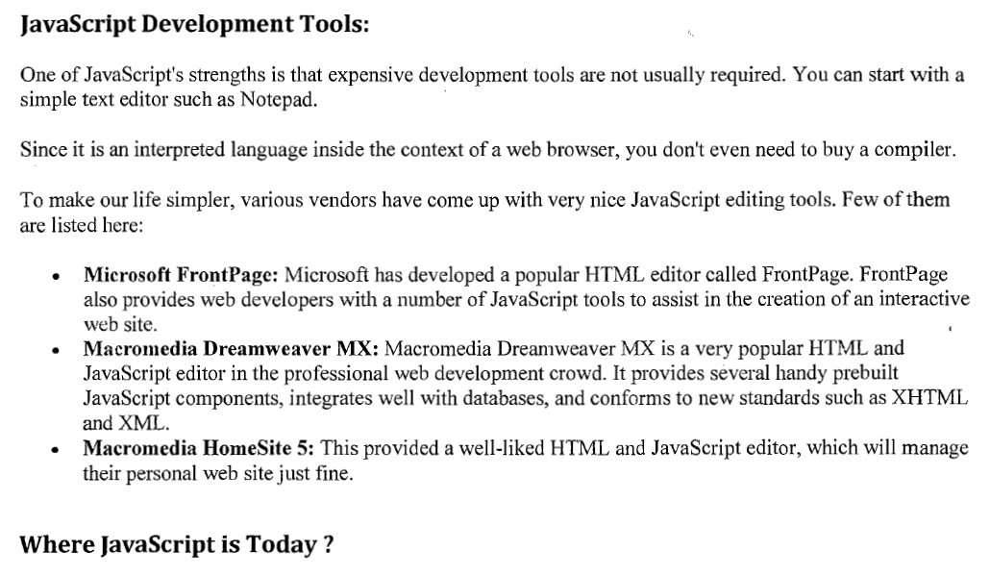

Slide 80
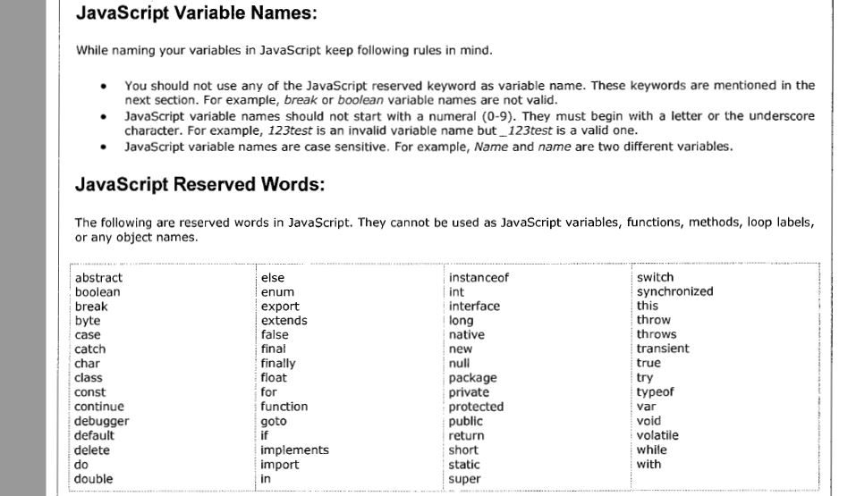
Javascript variables

Slide 81
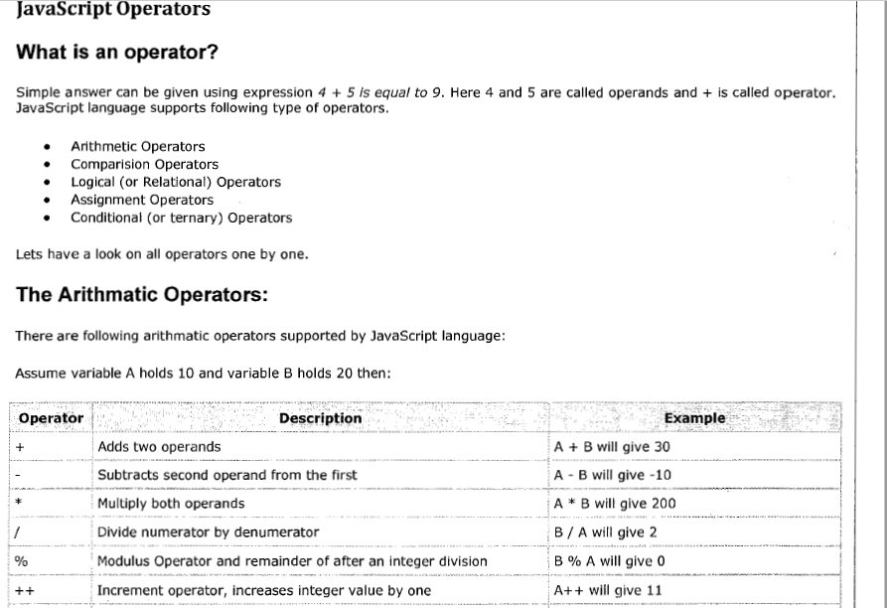

Slide 82
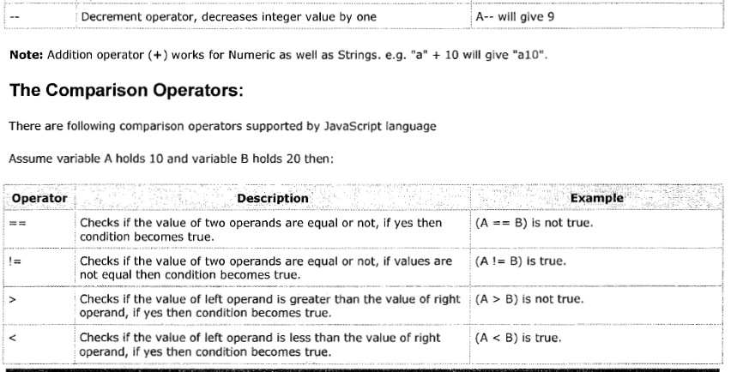

Slide 83
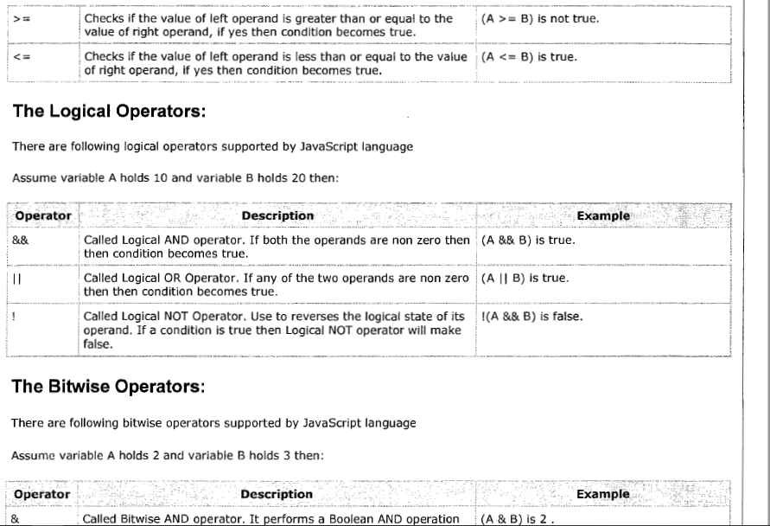

Slide 84
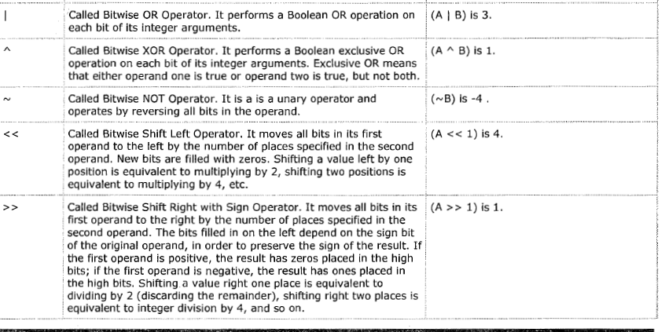

Slide 85
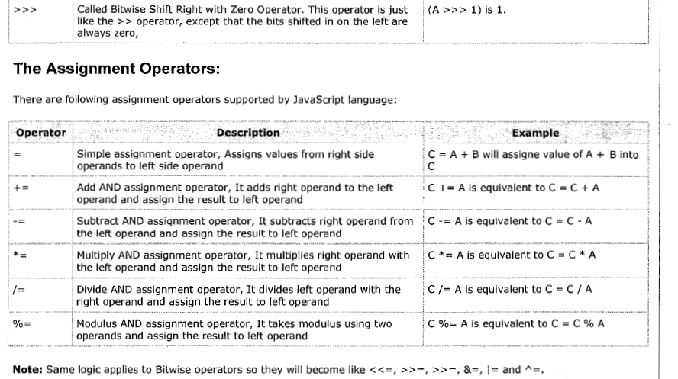

Slide 86
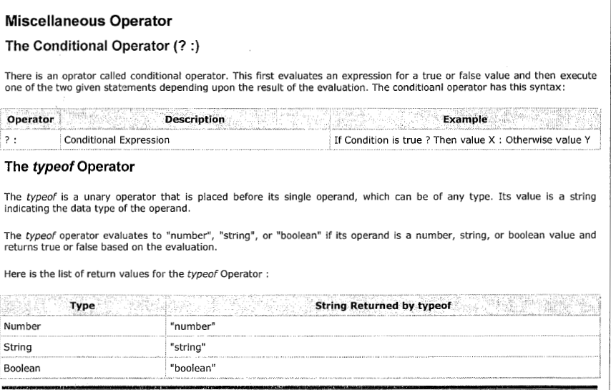

Slide 87
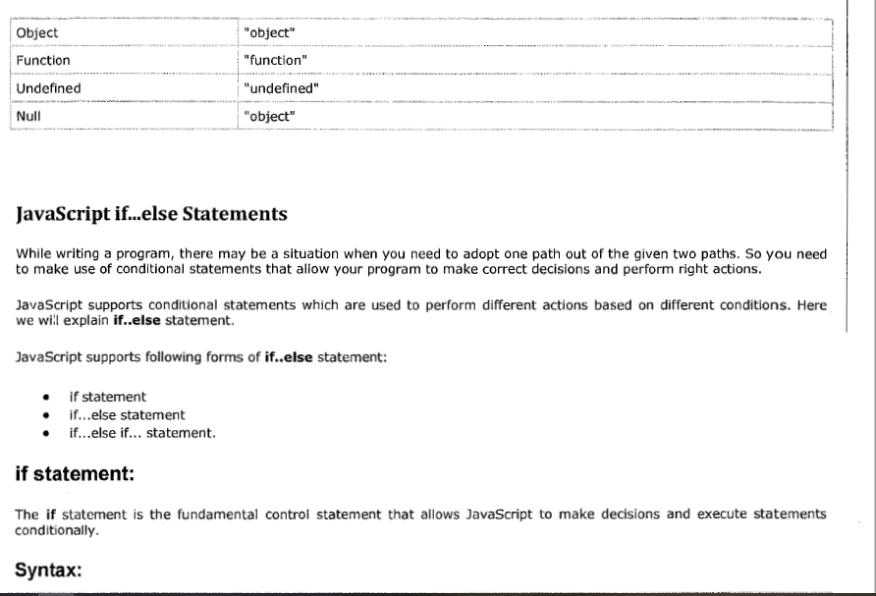

Slide 88
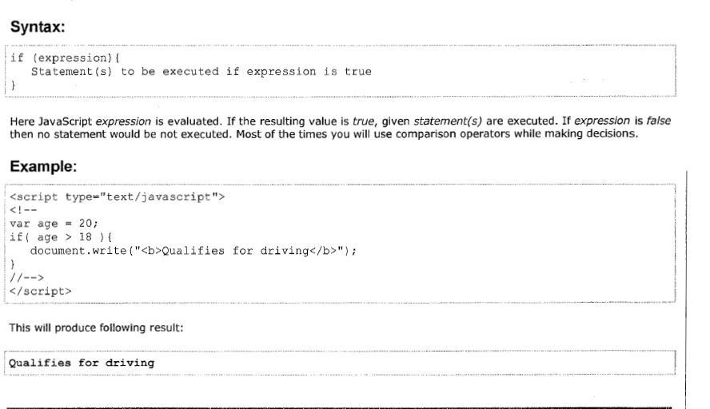

Slide 89
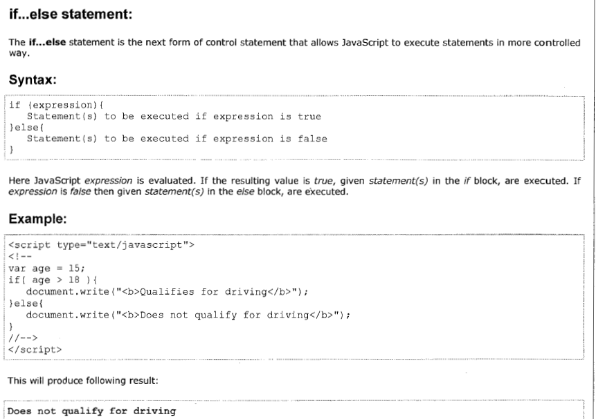

Slide 90
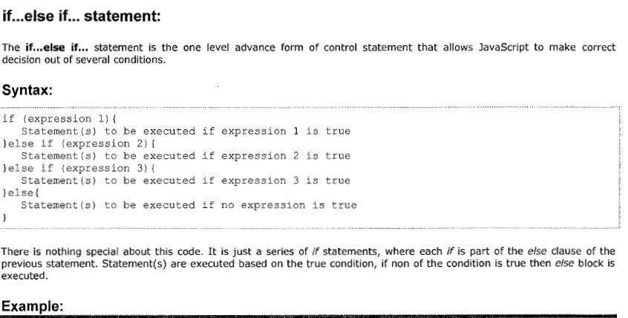

Slide 91
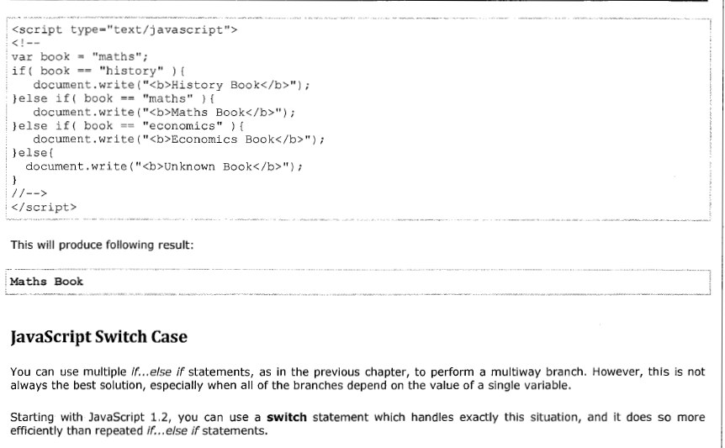

Slide 92
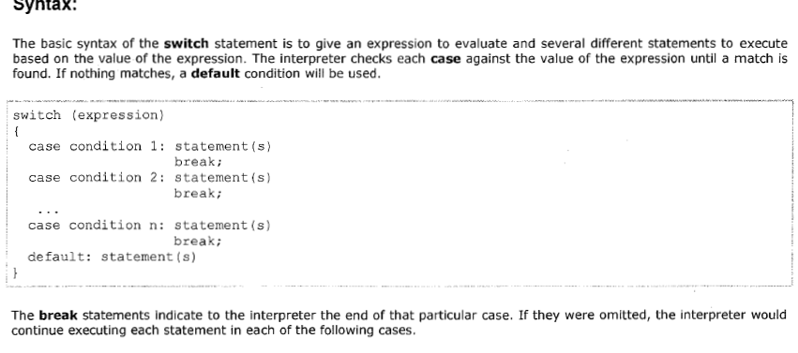

Slide 93
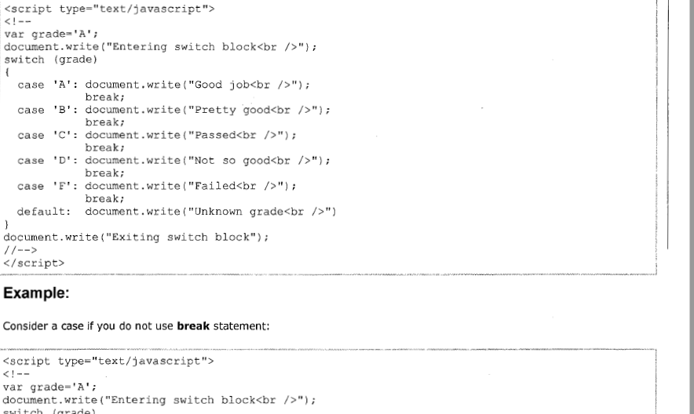

Slide 94
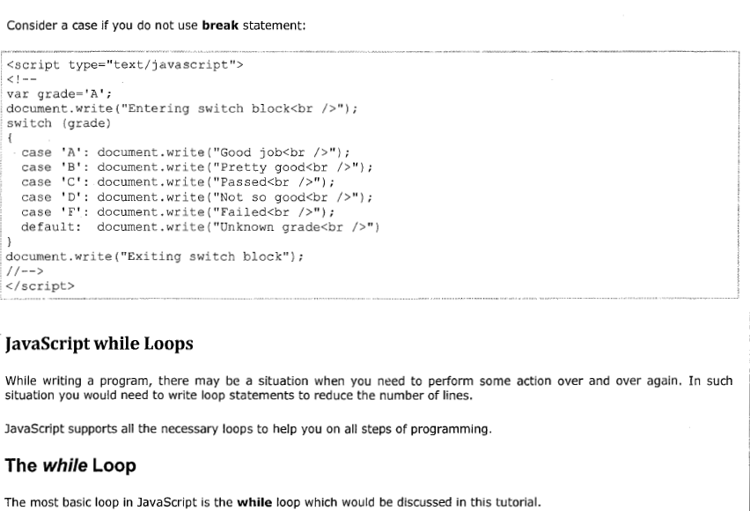

Slide 95
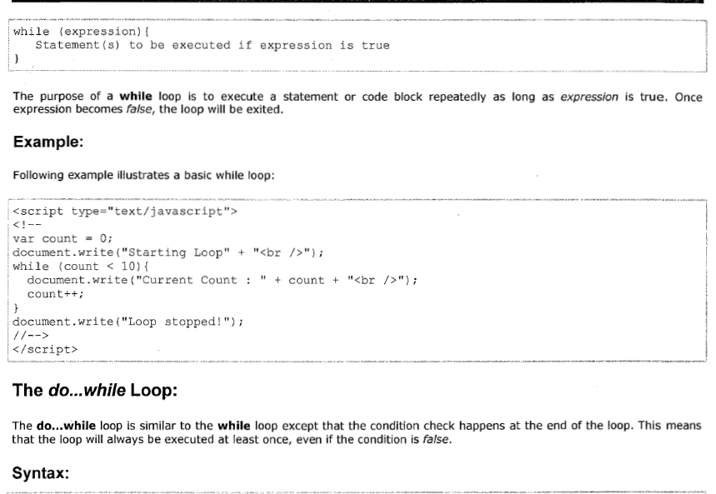

Slide 96
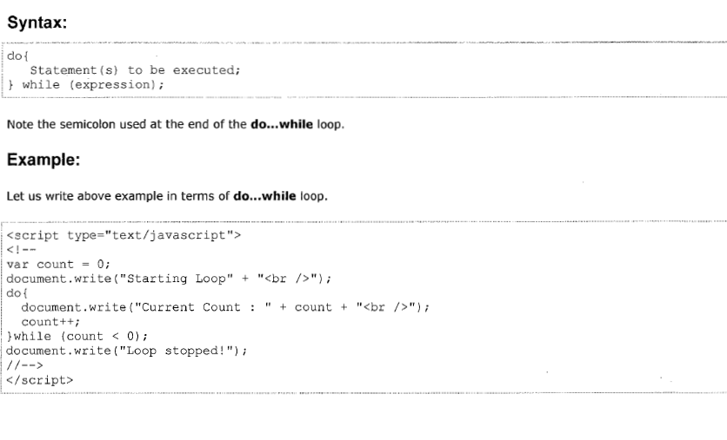

Slide 97
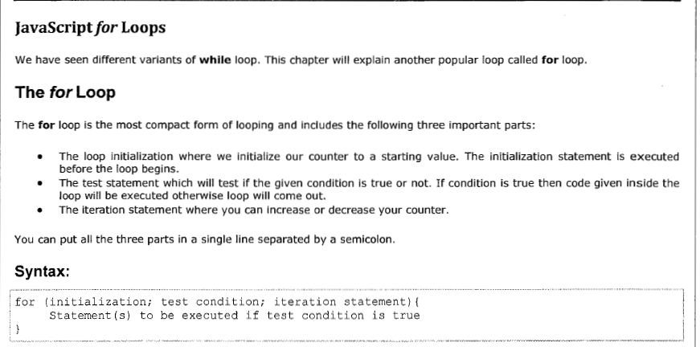

Slide 98
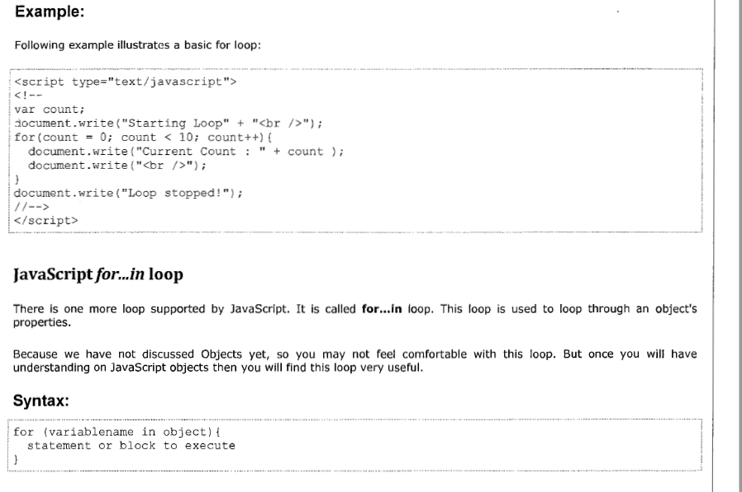

Slide 99
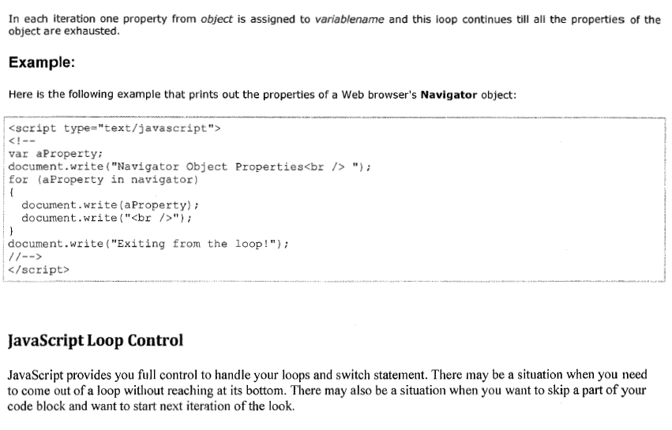

Slide 100
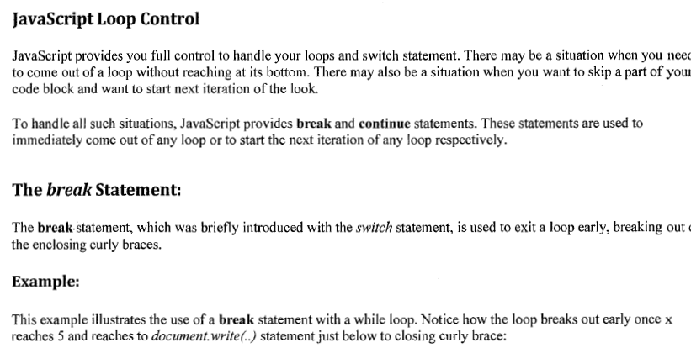

Slide 101
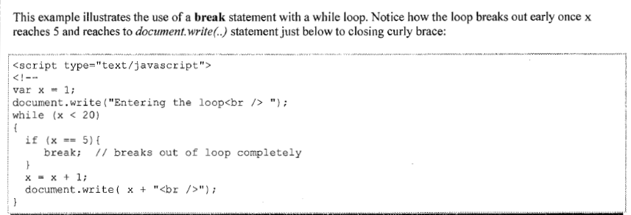

Slide 102
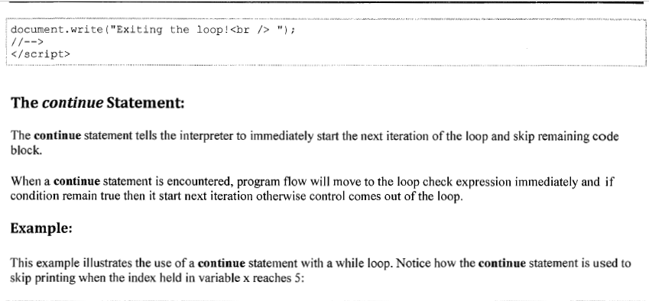

Slide 103
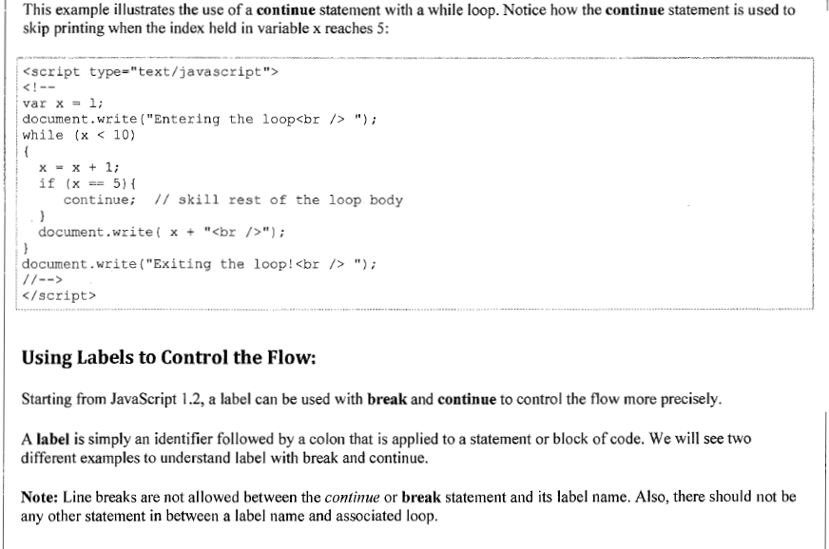

Slide 104
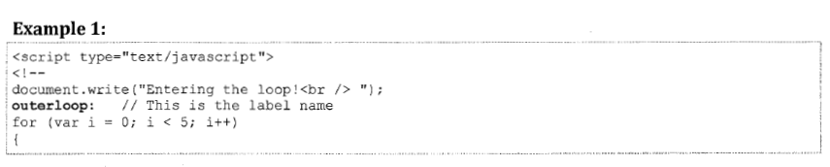
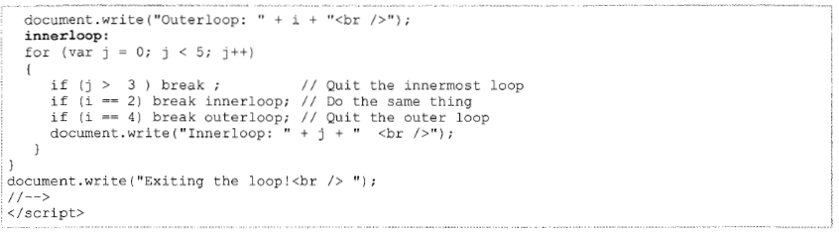

Slide 105
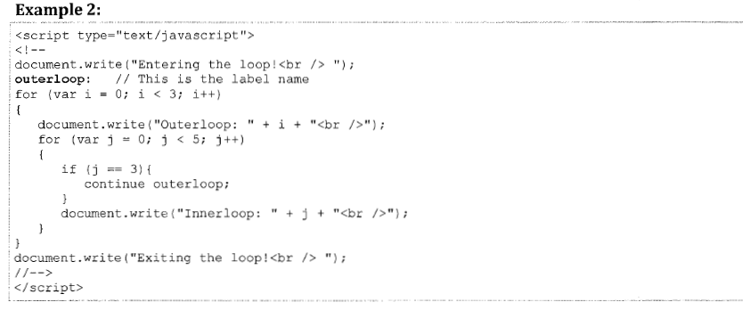

Slide 106
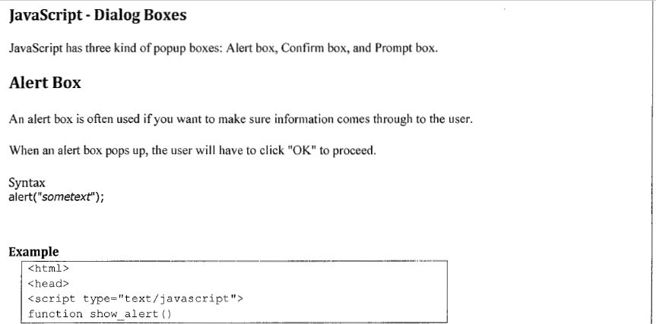

Slide 107
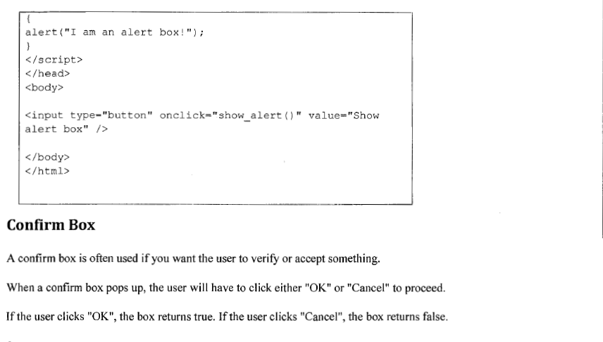

Slide 108
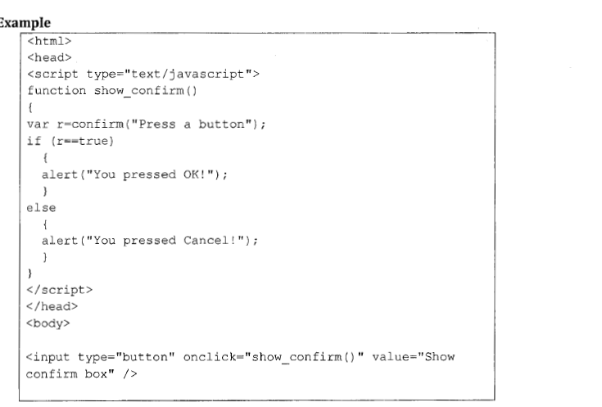

Slide 109
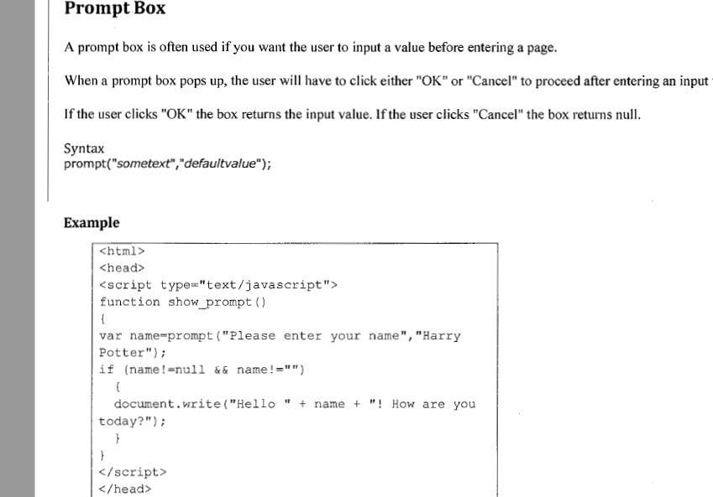

Slide 110
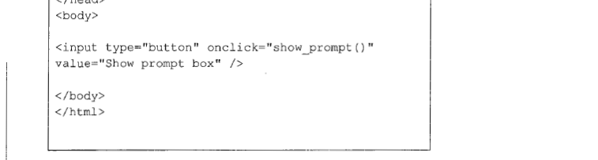
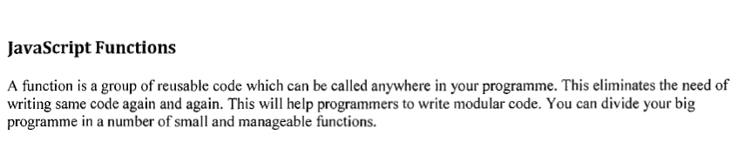
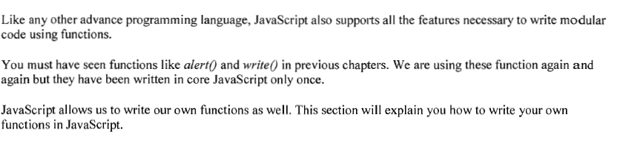

Slide 111
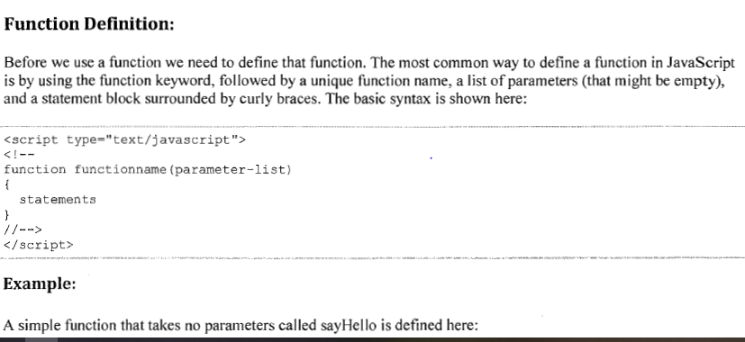
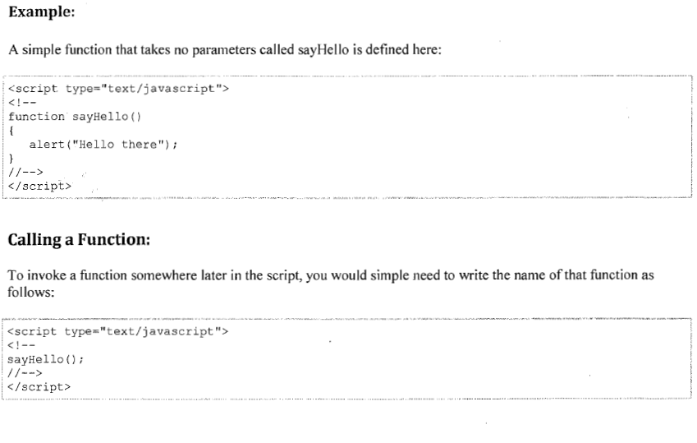

Slide 112
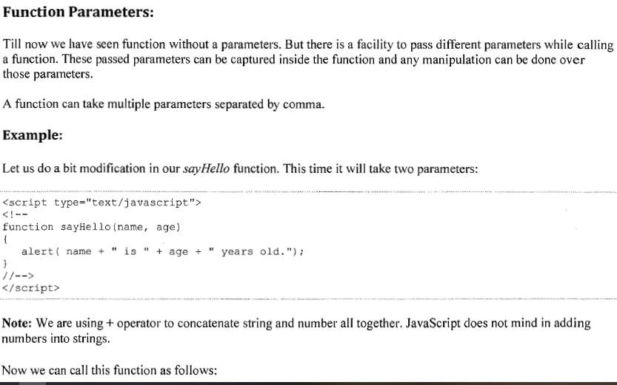

Slide 113
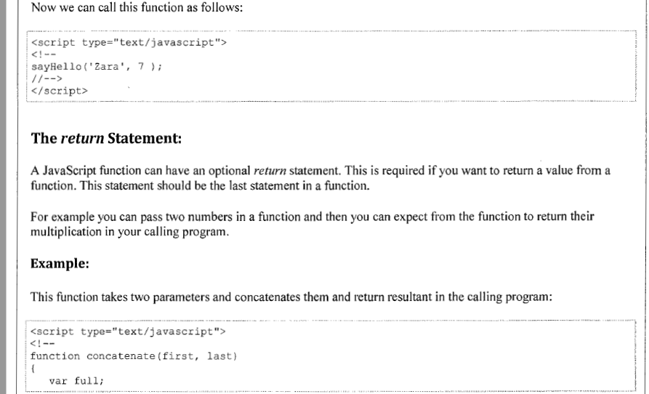

Slide 114
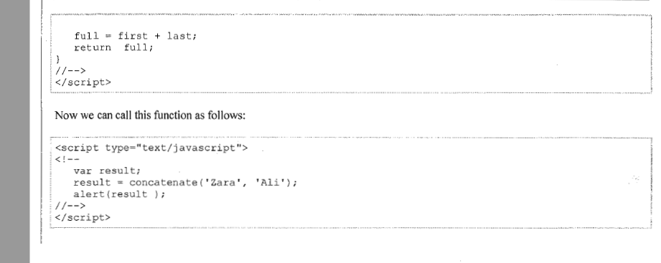

Slide 115
Strings : Used for storing and manuplating the text
String are in any language group of characters inside the quotes(single or double quotes)
Let Sandeep = “good morning”
Let sanvik = ‘good boy’
We can use the quotes inside the string as long as they don't match the quotes surrounding the string
Let Kishore = “Testing the ‘spring’ framework”; //valid syntax
Let ram = ‘Testing the “hibernate” framework’ // valid syntax
Build in properties.
Length – string.length // gives the number of characters in the string.
Escape characters:
strings must be written within quotes, JavaScript will misunderstand this string
Let test = “good morning “sandeep" you can do it";

Slide 116
The string will be chopped to "good morning".
The solution to avoid this problem, is to use the backslash escape character.
The backslash (\) escape character turns special characters into string characters
let text = "good morning \"sandeep\" you can do it.";
let test= ’good morning \’sandeep.’;
let test = "The character \\ is called backslash.";
You can also break up a code line within a text string with a single backslash
document.getElementById("demo").innerHTML = "Hello \
sandeep!";
document.getElementById("demo").innerHTML = "Hello " +
"Dolly!"; // best way

Slide 117
Normally, JavaScript strings are primitive values, created from literals:
let firstName = “sanvik";
But strings can also be defined as objects with the keyword new:
let firstName = new String(“sandeep");
String methods:
String methods help you to work with strings.
with JavaScript, methods and properties are also available to primitive values, because JavaScript treats primitive values as objects when executing methods and properties.
Extracting String Parts
There are 3 methods for extracting a part of a string:
slice(start, end) : slice() extracts a part of a string and returns the extracted part in a new string
Syntax
str.slice(8,10)
substring(start, end) : JavaScript counts positions from zero. First position is 0.
If a parameter is negative, the position is counted from the end of the string

Slide 118
substring(start, end)
substring() is similar to slice().
The difference is that substring() cannot accept negative indexes.
substr(start, length)
substr() is similar to slice().
The difference is that the second parameter specifies the length of the extracted part.
If the first parameter is negative, the position counts from the end of the string.
Replace()
The replace() method replaces a specified value with another value in a string
let text = “Sandeep is in class!";
let newText = text.replace(“sandeep", “kishore");
the replace() method is case sensitive.
To replace case insensitive, use a regular expression with an /i flag
let text = "Please visit tcs";
let newText = text.replace(/TCS/i, "infosis");

Slide 119
To replace all matches, use a regular expression with a /g flag
let text = "Please visit Microsoft and Microsoft!"; let newText = text.replace(/Microsoft/g, “TCS");

